Slide 1


SPRING VALLEY VILLAGE POLICE DEPARTMENT
MONTHLY NEWSLETTER:
MARCH 2026
1025 CAMPBELL ROAD
HOUSTON, TX 77055
PHONE: 713-465-8323
COMMUNITY MATTERS.
WE ARE A TEAM.

Slide 2

INTRODUCTION
Hilshire Village Residents,
Spring is just around the corner, which means warmer weather and Spring Break cannot be far behind. Below are a few things to keep in mind while you go about your daily activities. As always we are available whenever you have concerns.
KEEP IN MIND:
Be aware of increased activity regarding children playing outside.
Be sure to lock all doors and windows in your home, when you are not on the premises.
Be sure to set the alarm for your residence and vehicle.
Lock your vehicle when it is unoccupied and remove all your valuables.
Sincerely,
Chief M. Schulze
1025 CAMPBELL ROAD, HOUSTON, TX 77055
PHONE: 713-465-8323 / EMAIL: DISPATCH@SPRINGVALLEYTX.COM

Slide 3
PPublic Service Announcement (PSA) From Our Officers:
Make sure your garage and exterior doors are secured and locked at night. This includes your vehicles as well.
Sgt. T. Wood
Make sure your house numbers are large, visible, and lighted, if possible, to ensure a quick response in locating your residence.
Officer E. Gomez
Make sure your bicycles are secured for the night. As always be mindful of your package deliveries and secure them as soon as possible, or have a neighbor secure them for you.
Officer R. Martell
COMMUNITY MATTERS.
WE ARE A TEAM.
1025 CAMPBELL ROAD, HOUSTON, TX 77055 / PHONE: 713-465-8323 / EMAIL: DISPATCH@SPRINGVALLEYTX.COM

Slide 4



MARCH 2026
DATE | DAY | SPECIAL DAYS FOR THIS MONTH
03-08-2026 | SUNDAY | DAYLIGHT SAVINGS TIME BEGINS
03-09-2026 | MONDAY | SBISD SPRING BREAK BEGINS
03-13-2026 | FRIDAY | SBISD SPRING BREAK ENDS
03-17-2026 | TUESDAY | ST. PATRICK’S DAY
03-20-2026 | FRIDAY | FIRST DAY OF SPRING
COMMUNITY MATTERS.
WE ARE A TEAM.
1025 CAMPBELL ROAD, HOUSTON, TX 77055 / PHONE: 713-465-8323 / EMAIL: DISPATCH@SPRINGVALLEYTX.COM

Slide 5

COMMUNITY MATTERS.
WE ARE A TEAM.
1025 CAMPBELL ROAD, HOUSTON, TX 77055 / PHONE: 713-465-8323 / EMAIL: DISPATCH@SPRINGVALLEYTX.COM

Slide 6
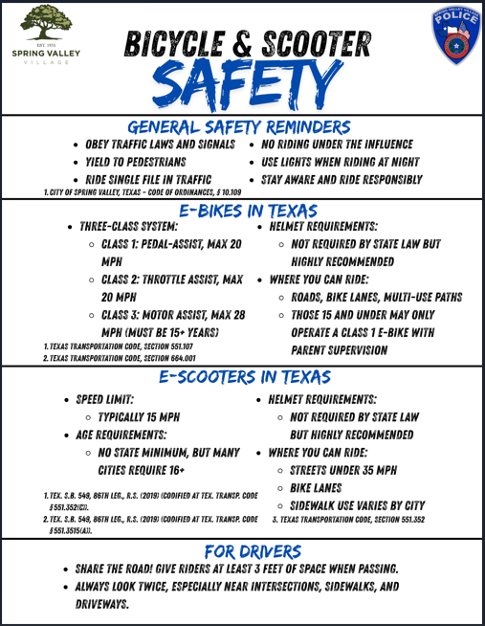

COMMUNITY MATTERS.
WE ARE A TEAM.
1025 CAMPBELL ROAD, HOUSTON, TX 77055 / PHONE: 713-465-8323 / EMAIL: DISPATCH@SPRINGVALLEYTX.COM

Slide 7

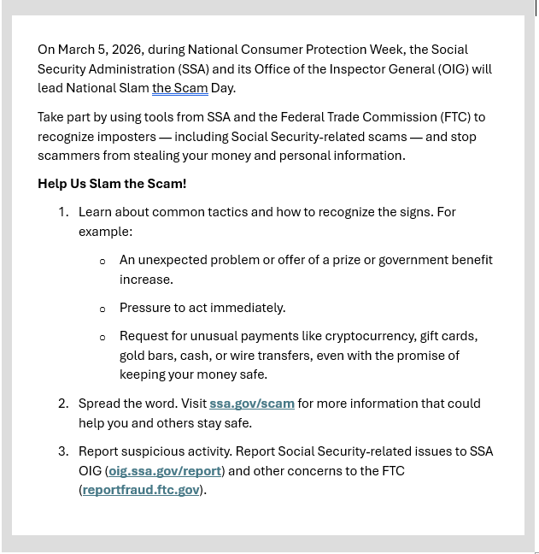
COMMUNITY MATTERS.
WE ARE A TEAM.
1025 CAMPBELL ROAD, HOUSTON, TX 77055 / PHONE: 713-465-8323 / EMAIL: DISPATCH@SPRINGVALLEYTX.COM

Slide 8
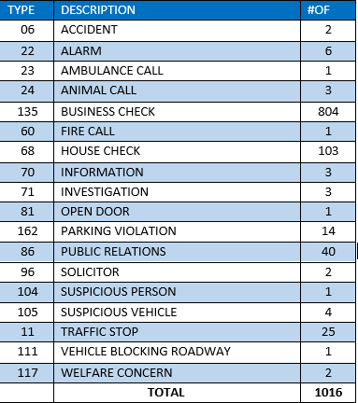
SPRING VALLEY POLICE DEPARTMENT
HILSHIRE VILLAGE
CALLS BY TYPE: 02-01-2026 THRU 02-28-2026
COMMUNITY MATTERS.
WE ARE A TEAM.
1025 CAMPBELL ROAD, HOUSTON, TX 77055
PHONE: 713-465-8323 / EMAIL: DISPATCH@SPRINGVALLEYTX.COM

Slide 9
IMPORTANT NUMBERS AT A GLANCE
EMERGENCY |  | NON - EMERGENCY
911 - FOR ALL EMERGENCY |  | 713-465-8323
988 – NATIONAL SUICIDE & MENTAL HEALTH
SPRING VALLEY VILLAGE |  | VILLAGE FIRE DEPARTMENT
SPRING VALLEY - CITY HALL | 713-465-8308 | VILLAGE FIRE DEPARTMENT |  | 713-465-2323
SPRING VALLEY - PD | 713-465-8323 | VFD - NON-EMERGENCY |  | 713-468-7941
SPRING VALLEY - PD FAX | 713-465-3135
SPRING VALLEY - COURT | 713-465-0333
HILSHIRE VILLAGE
HILSHIRE VILLAGE – CITY HALL | 713-973-1779
COMMUNITY MATTERS.
WE ARE A TEAM.
1025 CAMPBELL ROAD, HOUSTON, TX 77055 / PHONE: 713-465-8323 / EMAIL: DISPATCH@SPRINGVALLEYTX.COM

